Slide 1
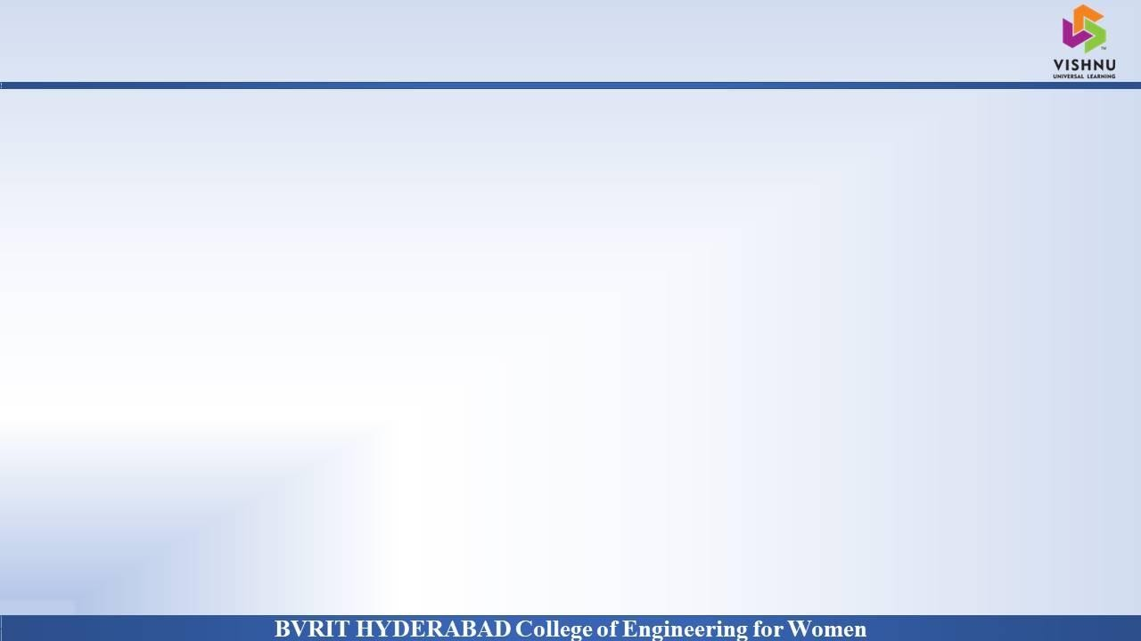
Department of Computer Science and Engineering
Vessel detection from space borne images
Date: 22 April 2021
Nikitha Kambhampati - 17WH1A0507
Pagilla Sai Preethi - 17WH1A0547
Gaddam Nikitha - 18WH5A0502
Internal Guide : Ms. C Jagadeeswari Designation : Assistant Professor

Slide 2


Abstract
Why Should I Study this course?
Examples
BVRIT HYDERABAD College of Engineering for Women
Problem Statement:
This project aims at detecting large vessels (ships) in sea from satellite images.
Ship detection from remote sensing imagery is a crucial application for maritime security which includes traffic surveillance, protection against illegal fisheries, oil discharge control and sea pollution monitoring.
Project Objective:
To build an algorithm to automatically detect and segment ships in satellite images. Some of the challenging factors include flaws in image quality like uneven brightness, obstruction, many images which have similar shape, color and texture.
Another problem is that objects like islands, ports, whales etc look quite similar to ships. The algorithm had to be extremely accurate because lives and billions of dollars in energy infrastructure is at stake. In this algorithm custom MASK R CNN is used for predicting with more accuracy.

Slide 3
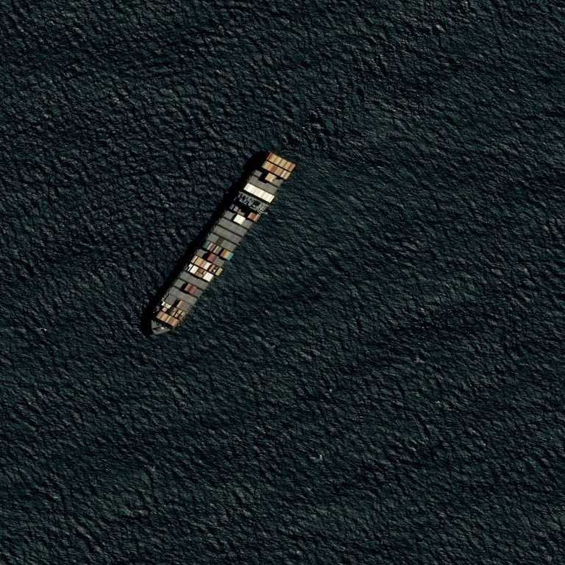
Dataset
Why Should I Study this course?
Examples
BVRIT HYDERABAD College of Engineering for Women
Dataset Description:
A public dataset from Kaggle on the Airbus Ship Detection Challenge is taken. The total size of the dataset is 29.25 Gb.
The dataset contains more than 2,00,000 768 × 768 images taken from satellite. (1,93,000 images – training data and 15,600 images– testing data)
Along with the images in the dataset, is a CSV file that lists all the images ids and their corresponding pixels coordinates.
These coordinates represent segmentation bounding boxes of ships. Not having pixel coordinates for an image means that particular image doesn’t have any ships.

Slide 4
Architecture
Why Should I Study this course?
Examples
BVRIT HYDERABAD College of Engineering for Women
Data Acquisition
Data pre-processing and visualisation
Data augmentation
Building a deep learning model based on CNN
Evaluating model on training data
Data interpretation and visualisation

Slide 5

Technology Stack
Why Should I Study this course?
Examples
BVRIT HYDERABAD College of Engineering for Women
Object Segmentation & detection – Convolutional Neural Networks(Algorithm)
Python Language
CNN implemented using TensorFlow as backend
Packages & Libraries :
NumPy , Pandas(Data analysis) , OS and CV2
Matplotlib (Plotting) , tqdm, Image Generator – Keras ( Data augmentation)
TensorFlow 2 (CNN), scikit – Image processing
N

Slide 6
System Requirements
Why Should I Study this course?
Examples
BVRIT HYDERABAD College of Engineering for Women
Environment | Speciﬁcations
Hardware | 128GB SSD Memory - 8GB RAM Intel I5 Core Processor
Software | OS: Microsoft 10 Jupyter notebook ( Python – TensorFlow) Kaggle API (data download)

Slide 7
Timeline
Why Should I Study this course?
Examples
BVRIT HYDERABAD College of Engineering for Women
Review 0 | Identifying Business Case Requirements & Speciﬁcations
Review 1 | Data Gathering Data Preprocessing and data augmentation
Review 2 | Data Segmentation Algorithms( TensorFlow –CNN, Masked CNN ,Fast RCNN / UNet Model) Data Validation and visualisation
Review 3 | Data Prediction
 | Project report

Slide 8
References
Why Should I Study this course?
Examples
BVRIT HYDERABAD College of Engineering for Women
Base paper:
http://www.ijstr.org/final-print/dec2019/Real-Time-Detection-And-Segmentation-Of-Ships-In-Satellite-Images.pdf
References:
Airbus Ship Detection
https://www.kaggle.com/c/airbus-ship-detection/data
An intelligent ship detection using CNN
https://www.hindawi.com/journals/complexity/2020/1520872/
Ship detection using high resolution satellite imagery
https://earth.esa.int/eogateway/documents/20142/37627/8-Ship-Detection-High-Res-Satellite-Imagery.pdf

Slide 9
Thank you

